Slide 1
Indicators Across Incomes
A Framework for Mapping Disparate Societal Conditions
Max Goshert (presenter),
Michael Crow, PhD (coauthor)
Presented at the Atlanta Conference on Science and Innovation Policy; May 14, 2025

Slide 2




Run of Show
1. The 1/3 Country Concept
2. Methodological Framework
3. Indicator Visualizations
4. Future Direction

Slide 3
The Challenge & Need for Reoriented Science Policy
The core challenge: Despite advancements, the U.S. faces persistent societal problems (socioeconomic disparities, unequal opportunity).
Innovation for whom? The current national innovation system isn't translating progress into equitable outcomes for all Americans.
Informed by Dr. Crow’s prior work: Existing science funding and institution structures are not intentionally designed to link basic research directly to inclusive solutions for complex societal problems.

Slide 4


Slide 5
The 1/3 Country Concept
Concept Origin: Conceptualized by Dr. Michael Crow.
Framework: Reimagines the U.S. population as three distinct income-based "countries":
Bottom Third: Facing unprecedented stagnation or decline in key indicators, often lacking access to the benefits of technological progress.
Middle Third: Conditions often akin to developed European nations.
Top Third: Indicators accelerating at record levels.
Purpose: To move beyond national averages which obscure significant socioeconomic disparities and hinder effective policy.

Slide 6
Operationalizing the 1/3 Country Framework
A novel methodological approach
Objective: Develop a methodology to compare diverse societal outcomes using household income position as the fundamental axis.
Unit of Analysis: Income quantiles, specifically 60 granular, consecutive groups (terciles divided into 20 ventiles each).
Allows for the examination of how indicators vary between and within “countries”.
Method: Weighted summary statistics calculated for each group; income imputation used where needed for consistency.
Data Sources: IPUMS ACS, CPS supplements (ASEC, FSS, Voting), NHIS.

Slide 7
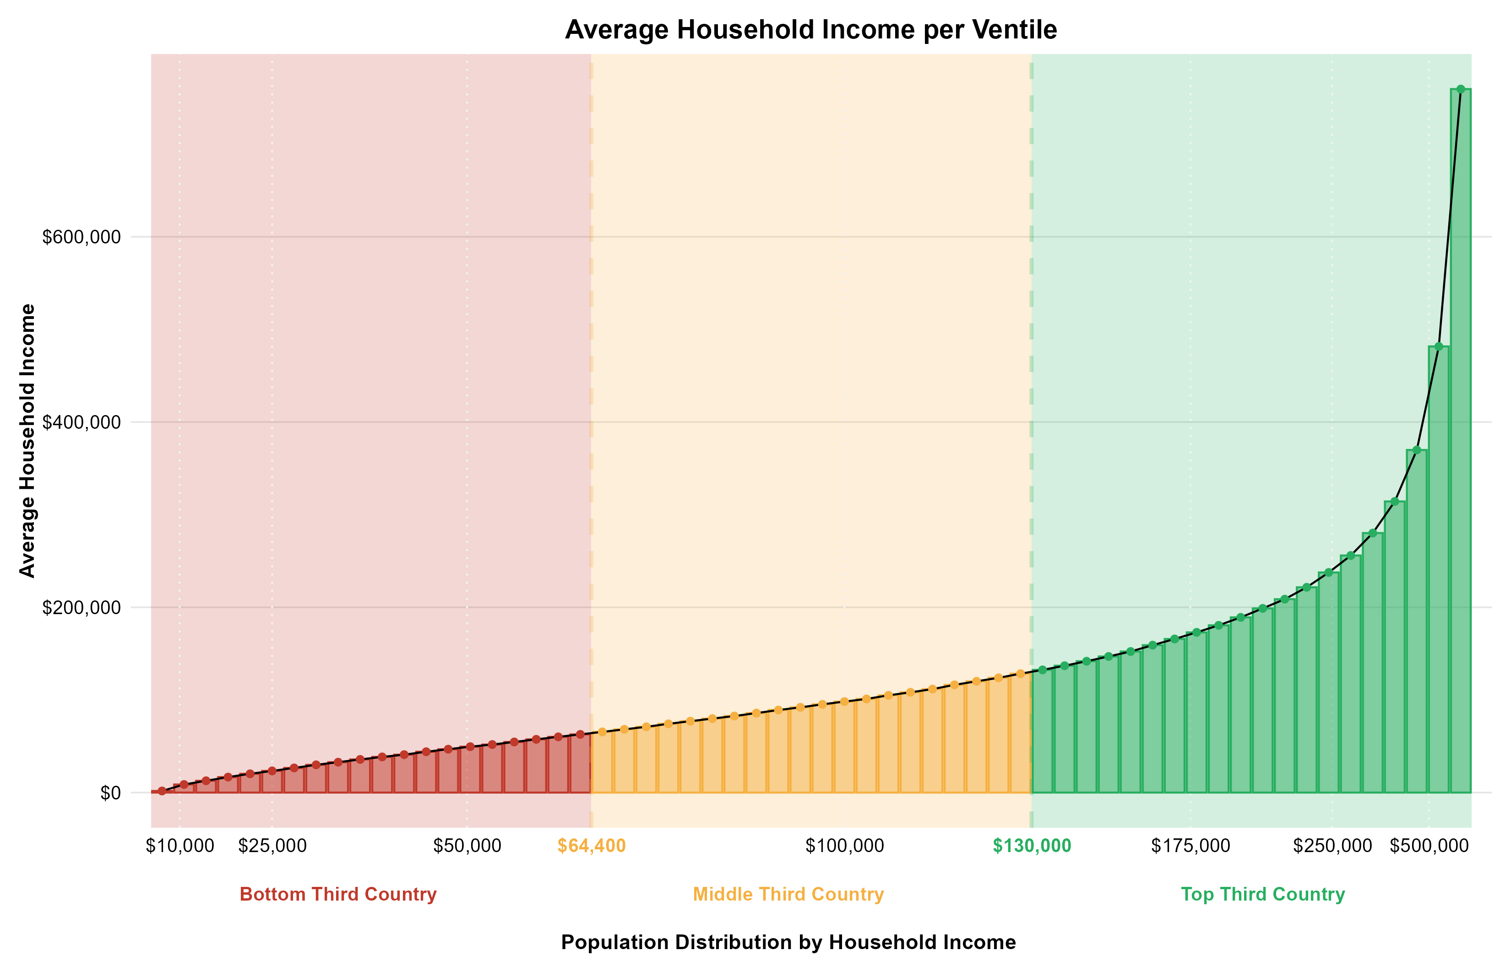
Operationalizing the 1/3 Country Framework
Ventiles within “Country” Terciles

Slide 8
Indicator Visualizations

Slide 9
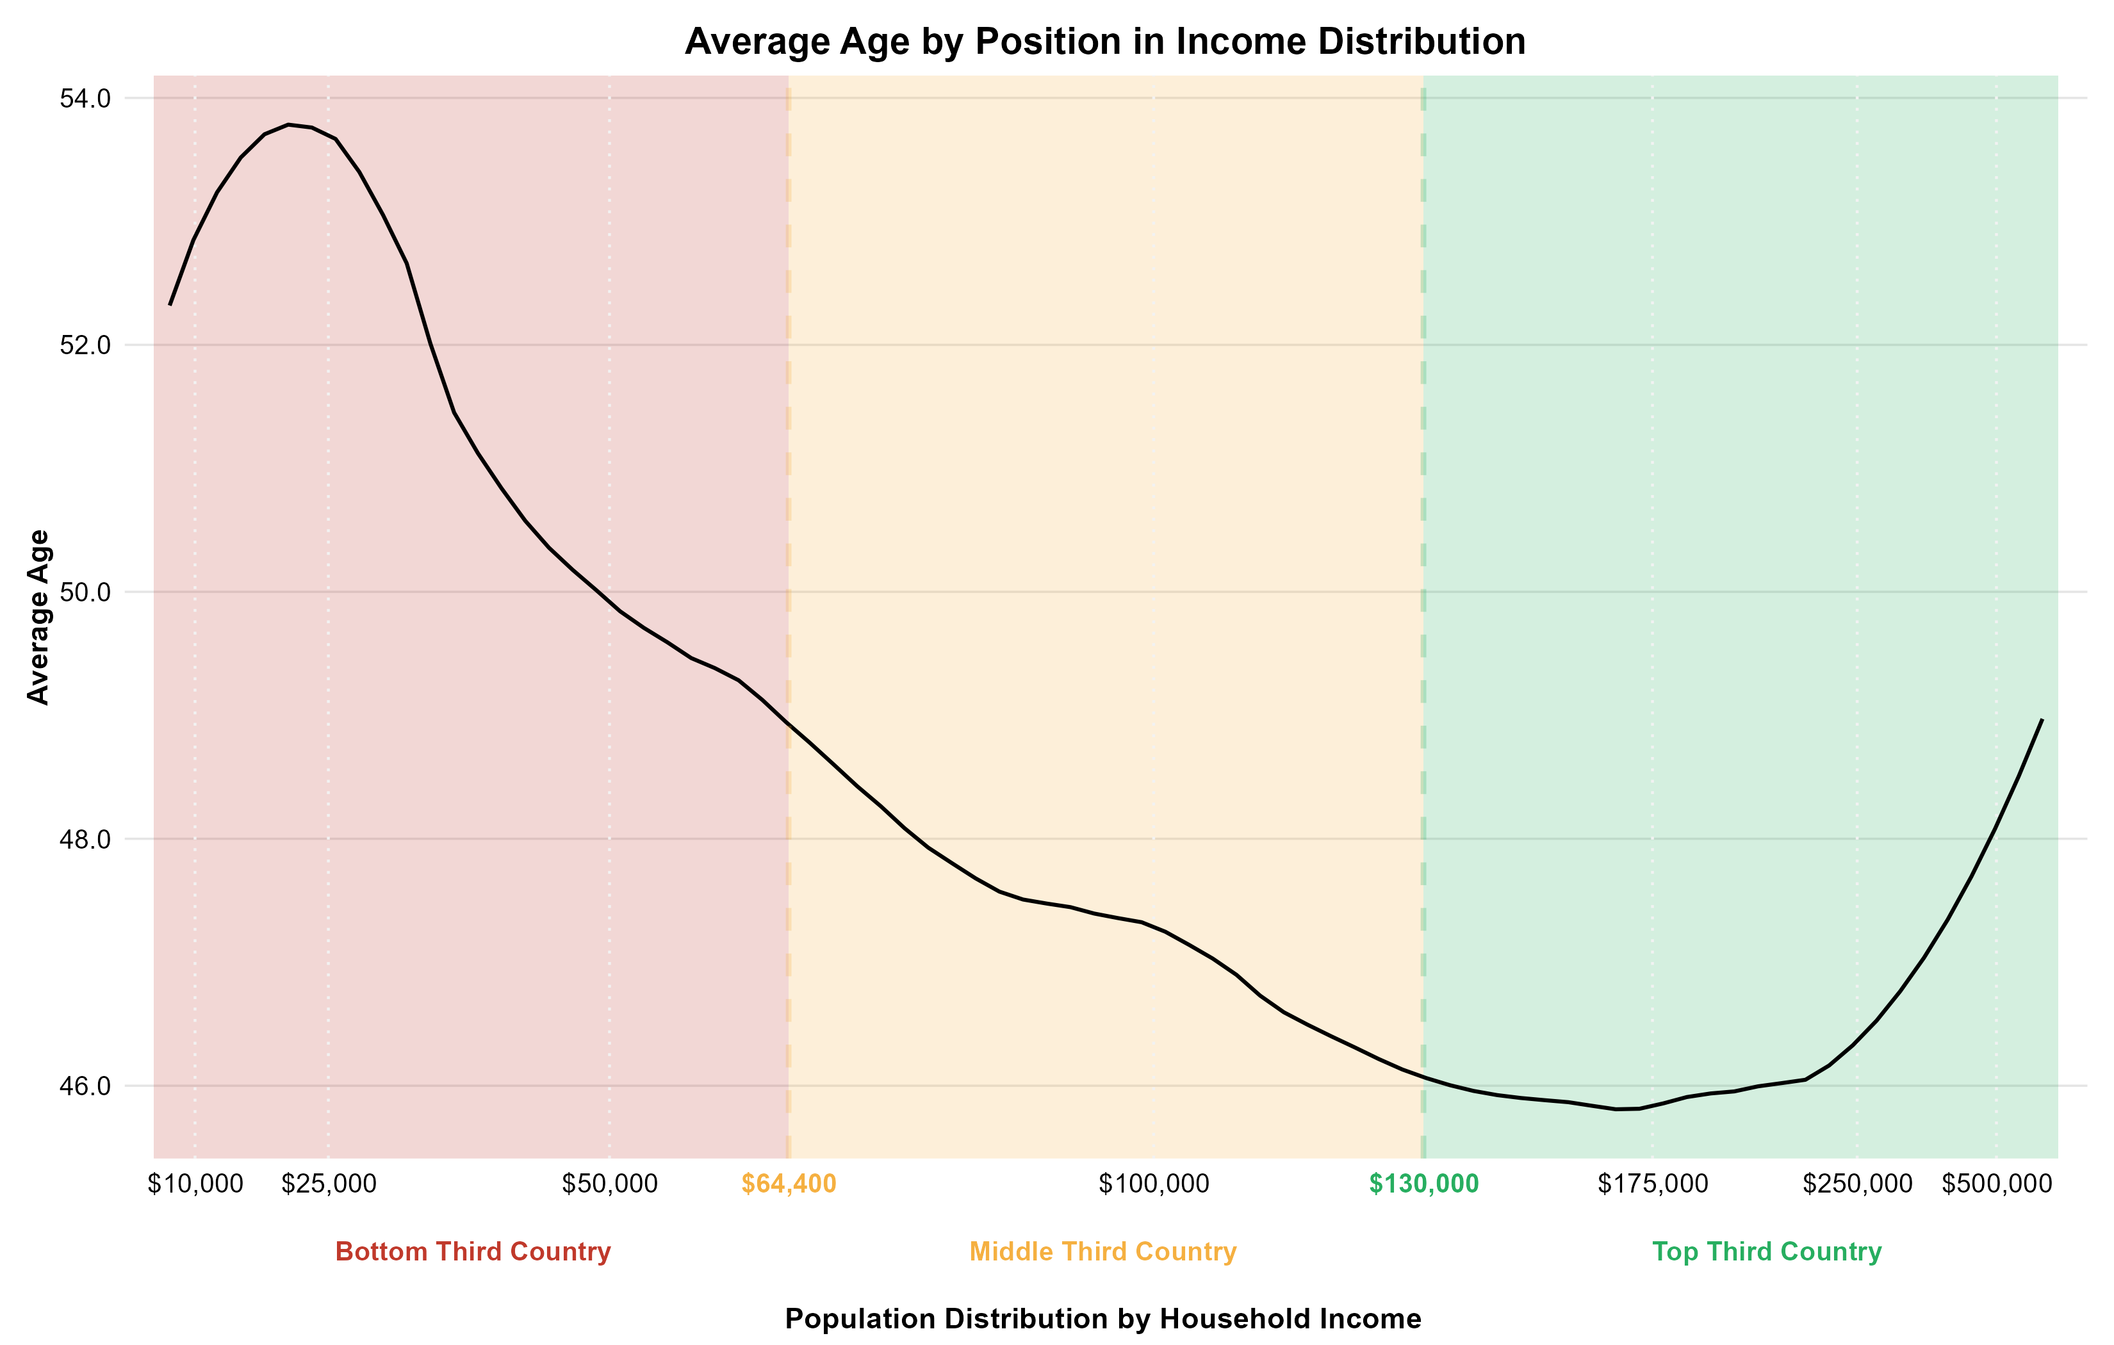
Average Age
Demographics

Slide 10
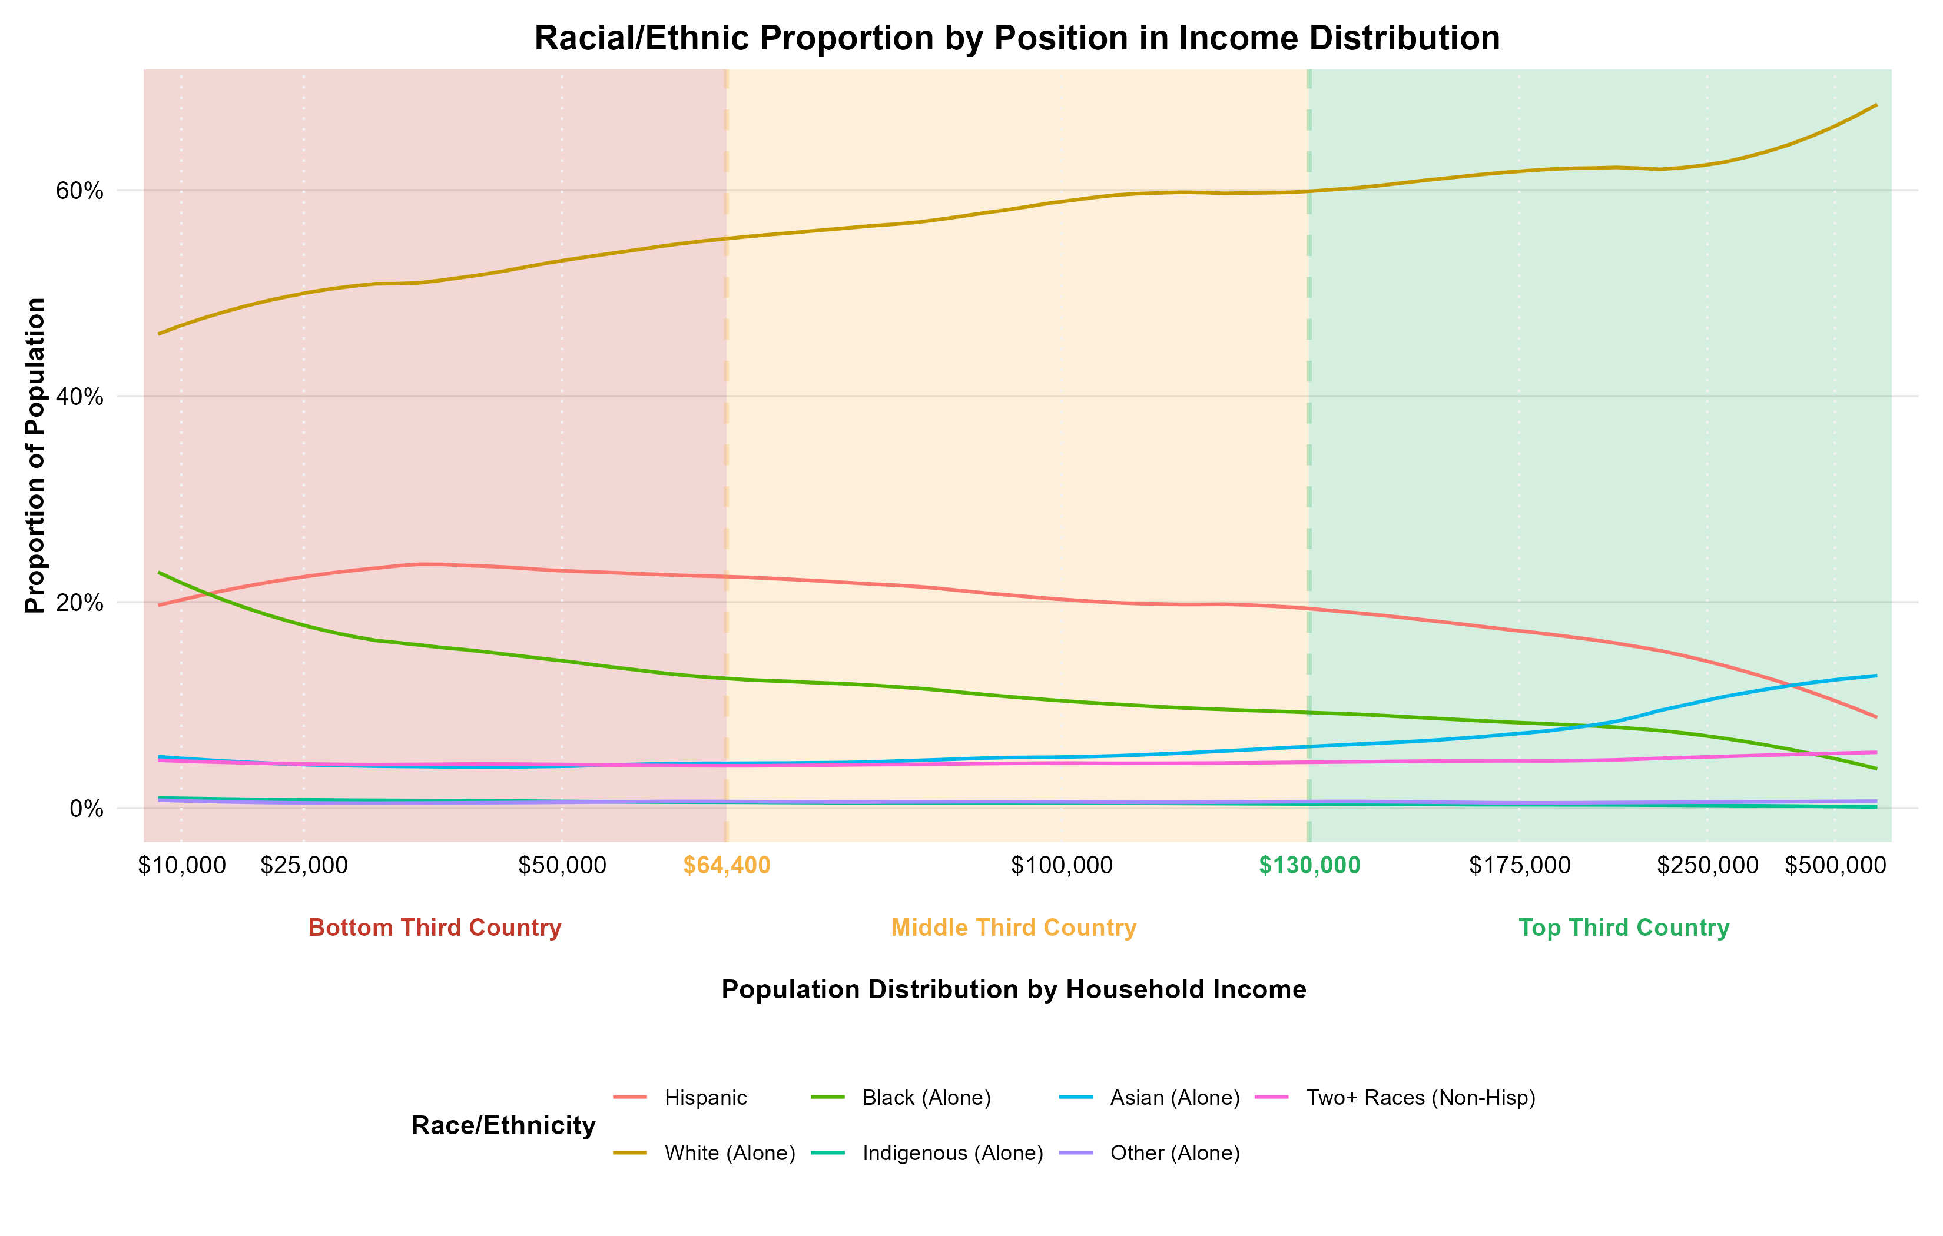
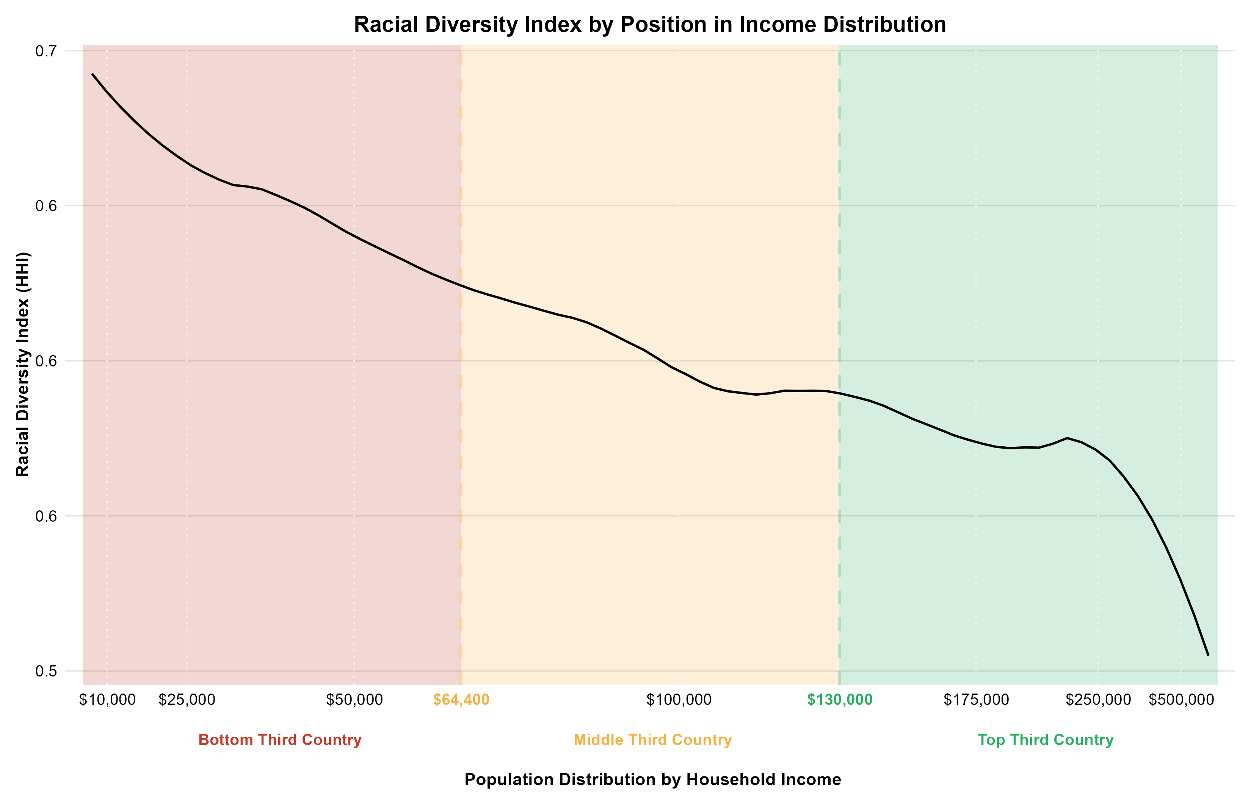
Racial Diversity
Demographics

Slide 11
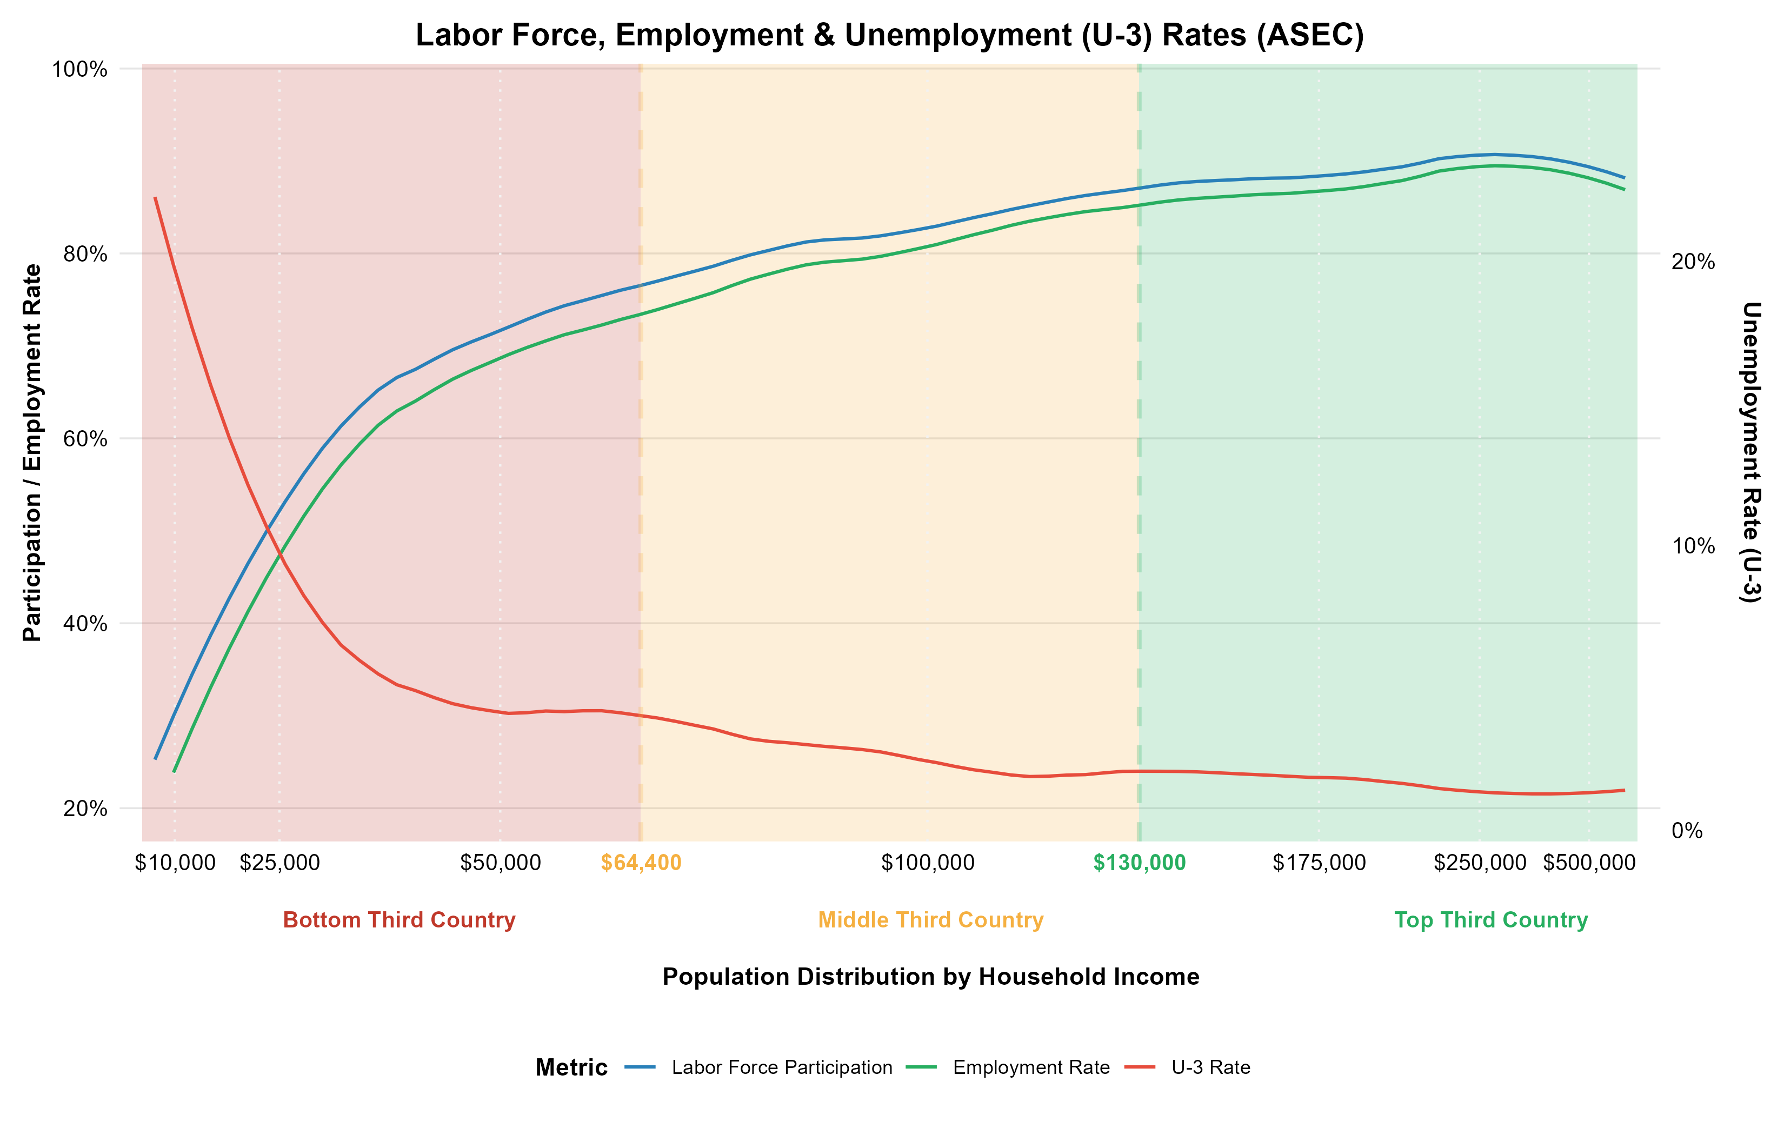
Labor Force and Employment
Economic Opportunity

Slide 12
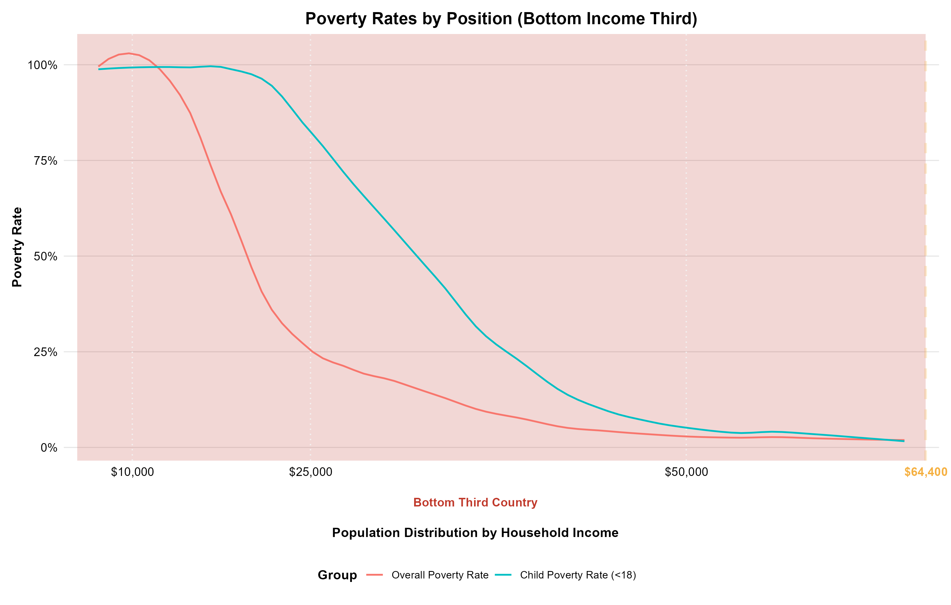
Poverty Rates (Bottom Third Country)
Economic Opportunity

Slide 13
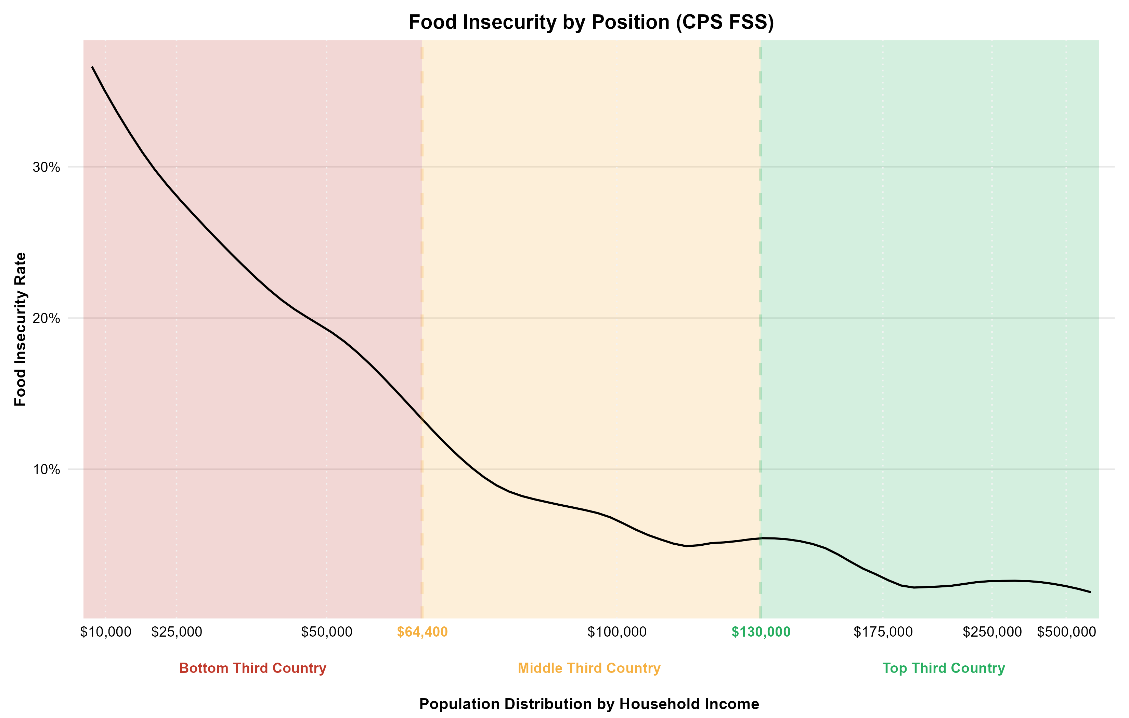
Food Insecurity
Economic Opportunity

Slide 14
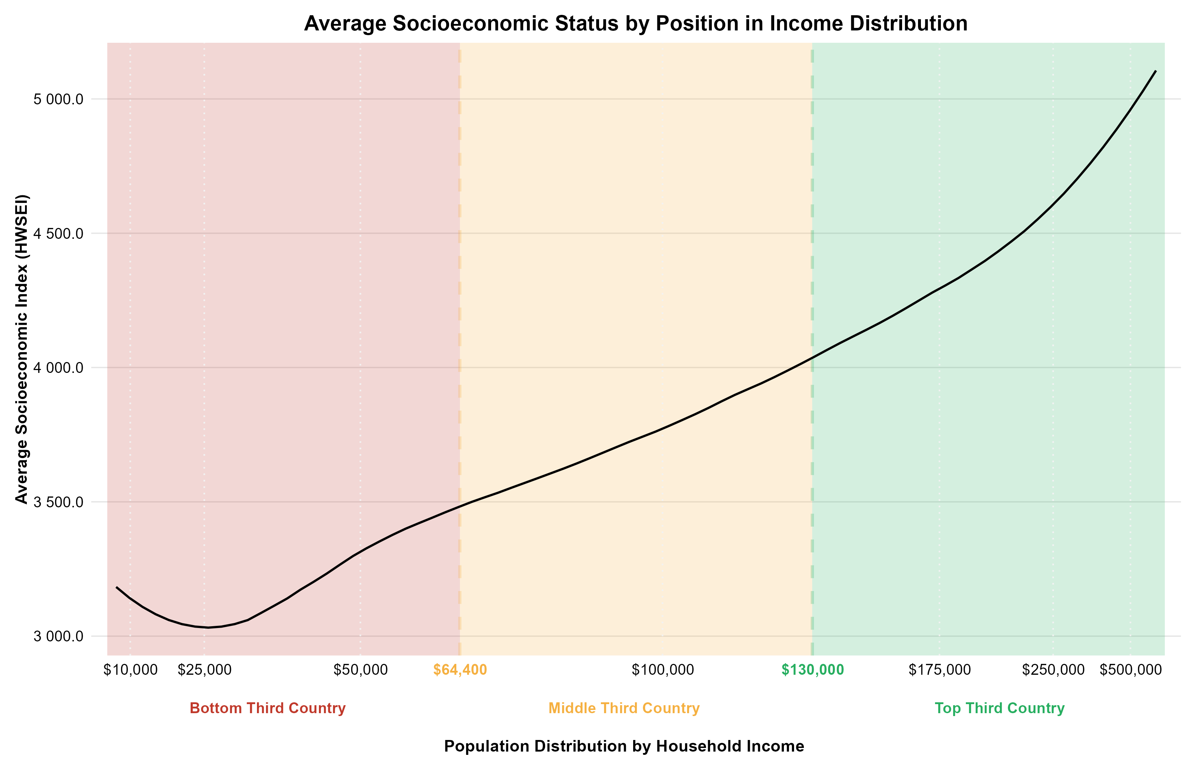
Socioeconomic Status (HWSEI)
Economic Opportunity

Slide 15
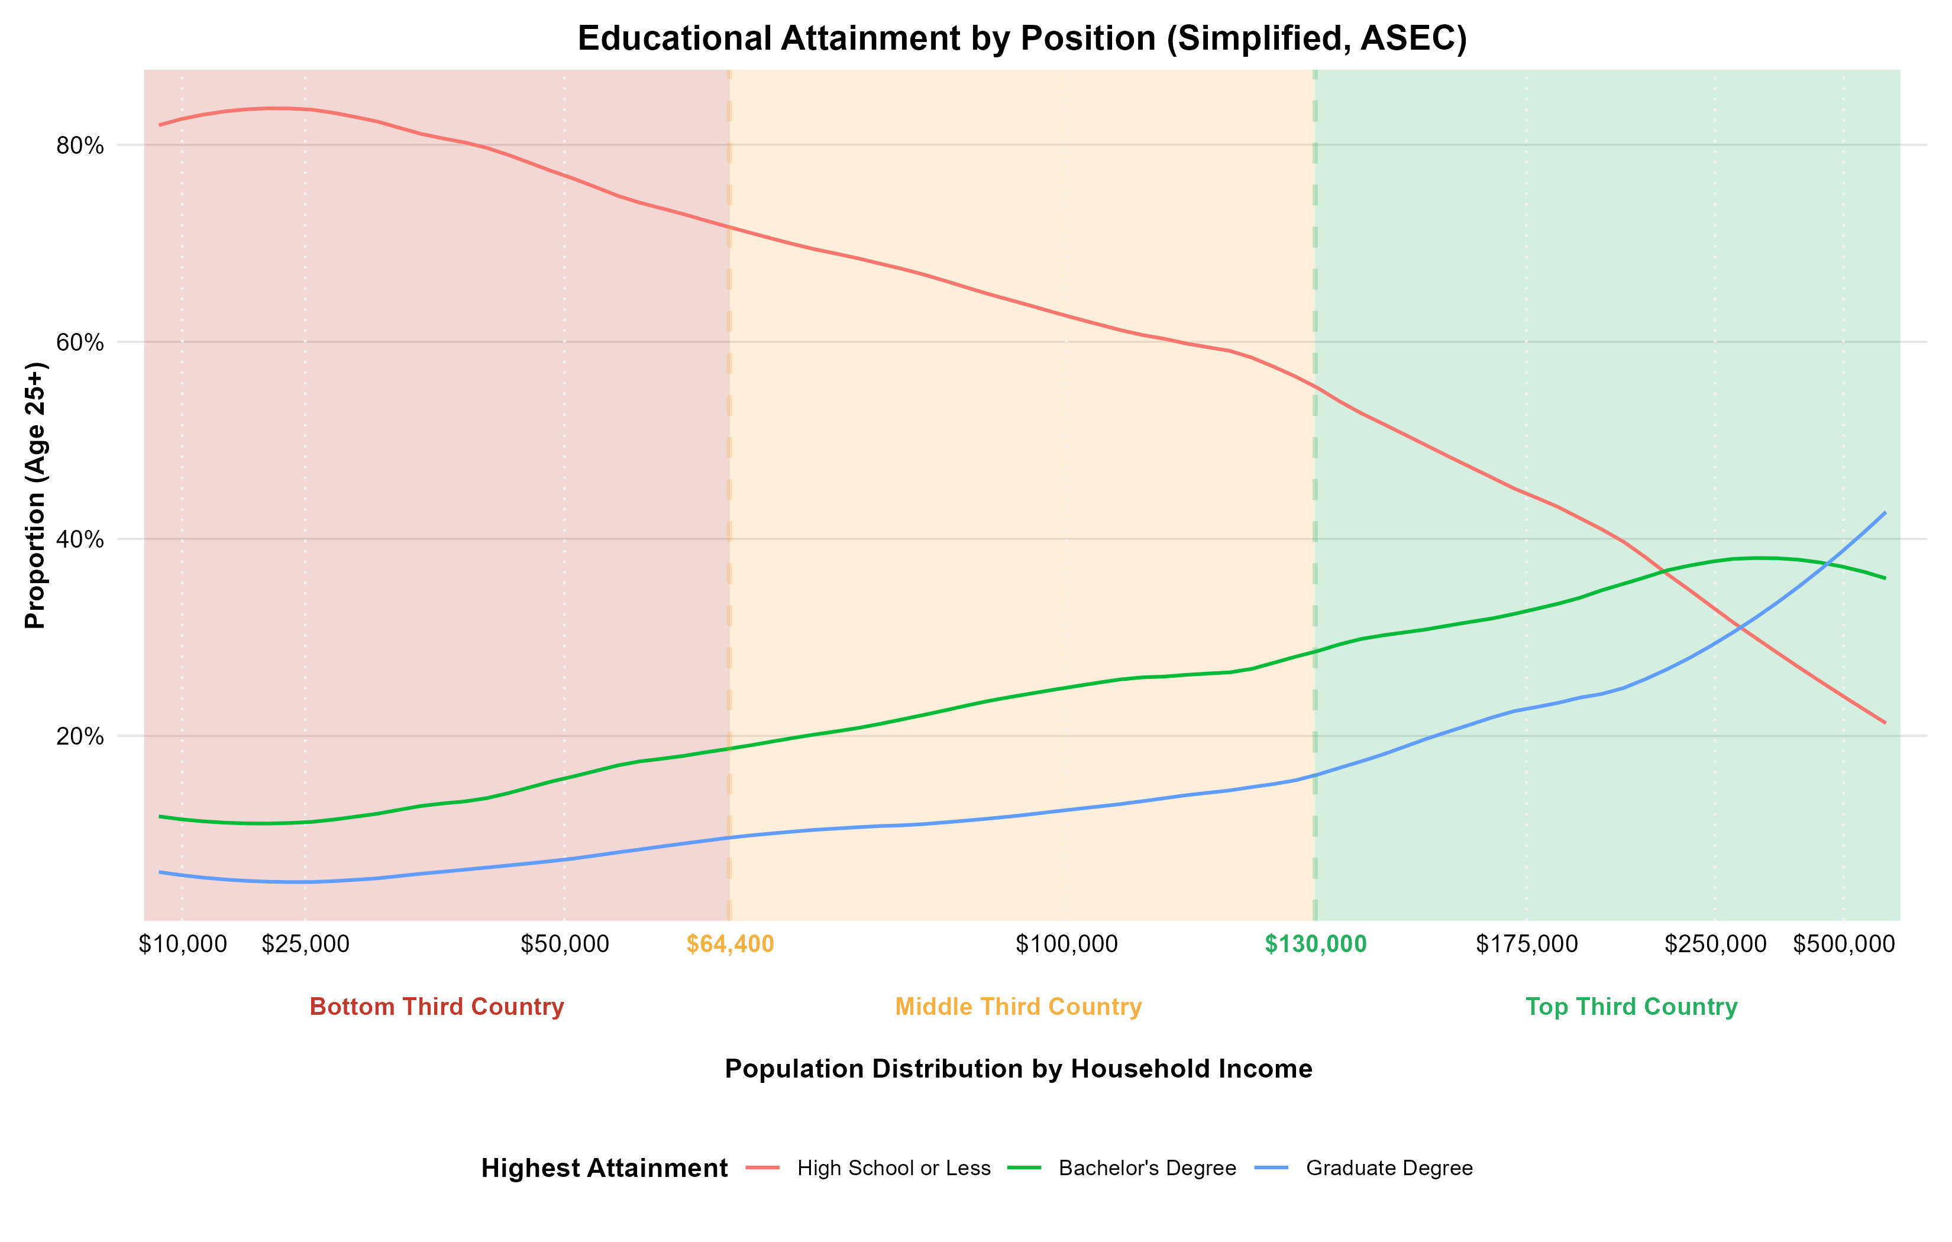
Educational Attainment
Education

Slide 16
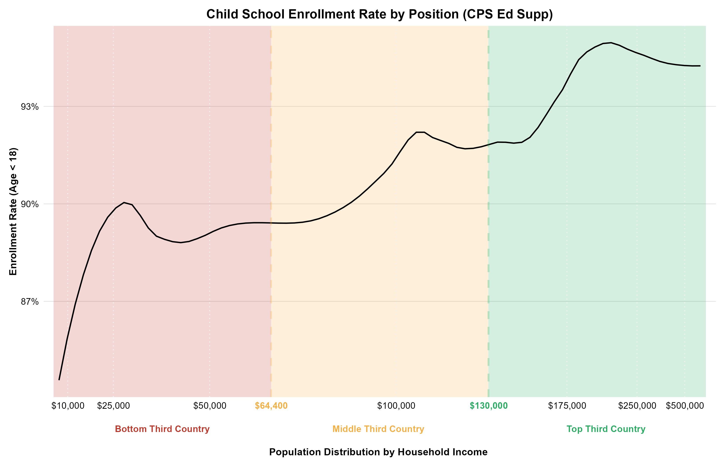
Child School Enrollment
Education

Slide 17
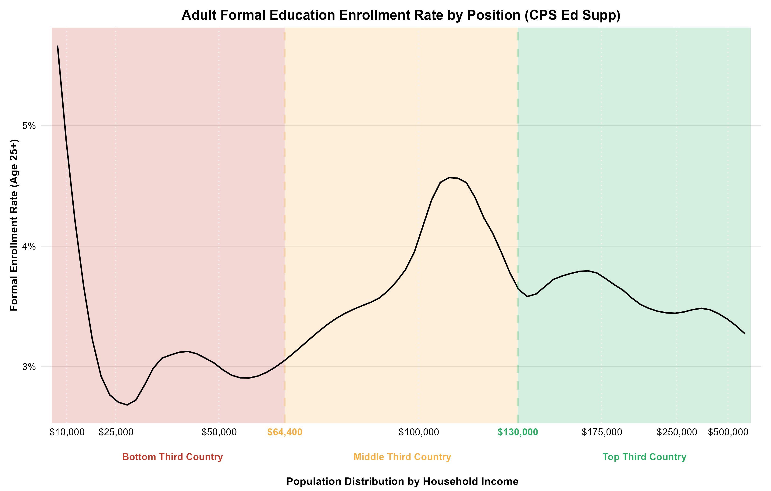
Adult Formal Education Enrollment
Education

Slide 18
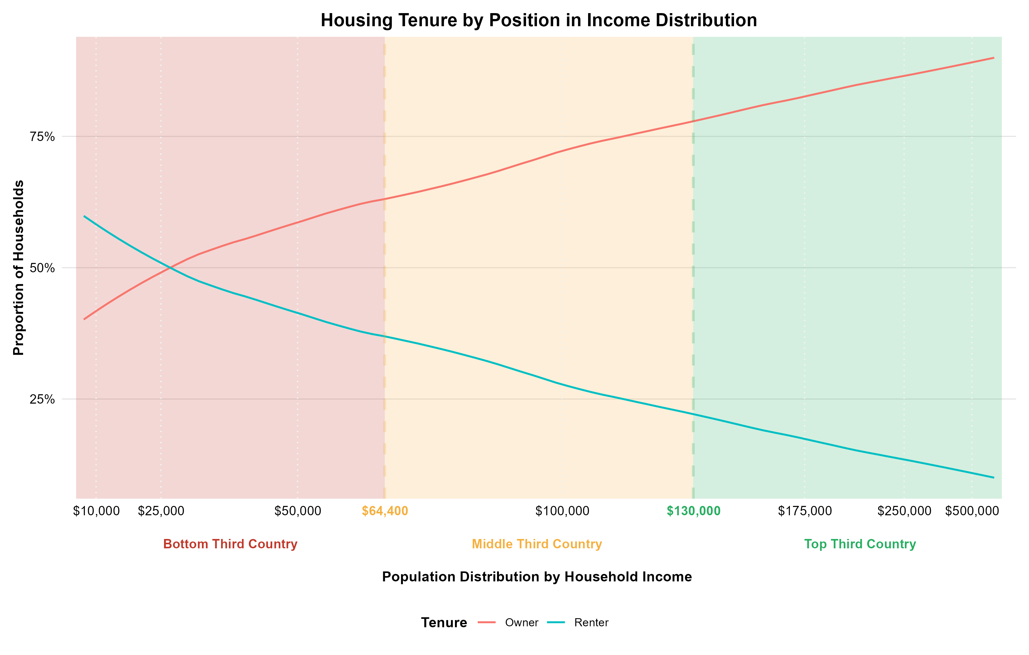
Homeownership vs. Renting
Housing

Slide 19
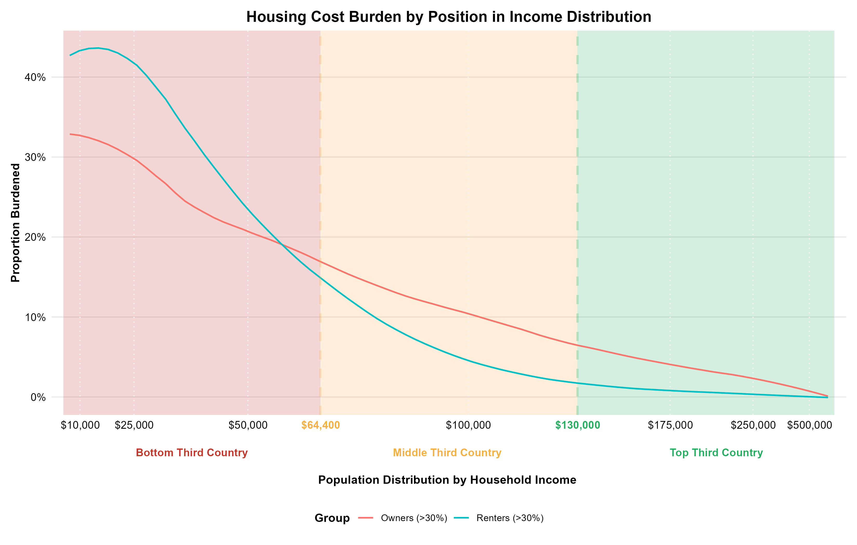
Housing Cost Burden (>30% of income)
Housing

Slide 20
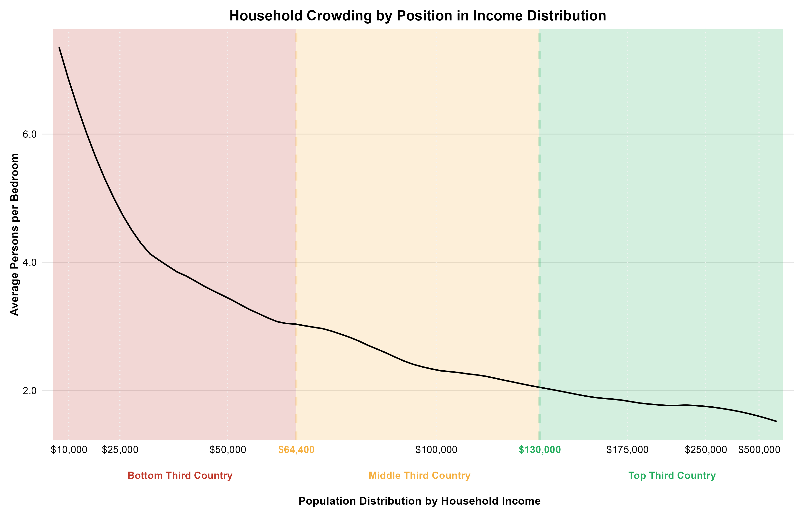
Household Crowding
Housing

Slide 21
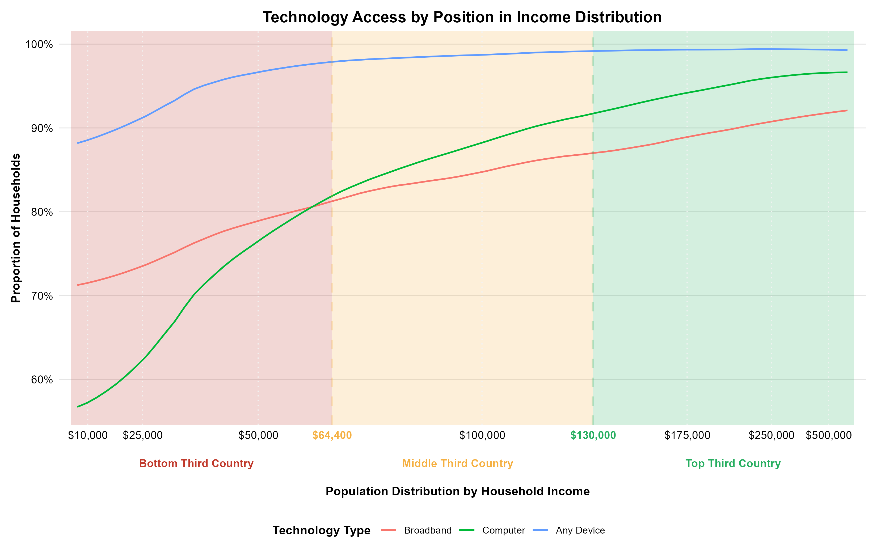
Access to Internet and Technology
Housing

Slide 22
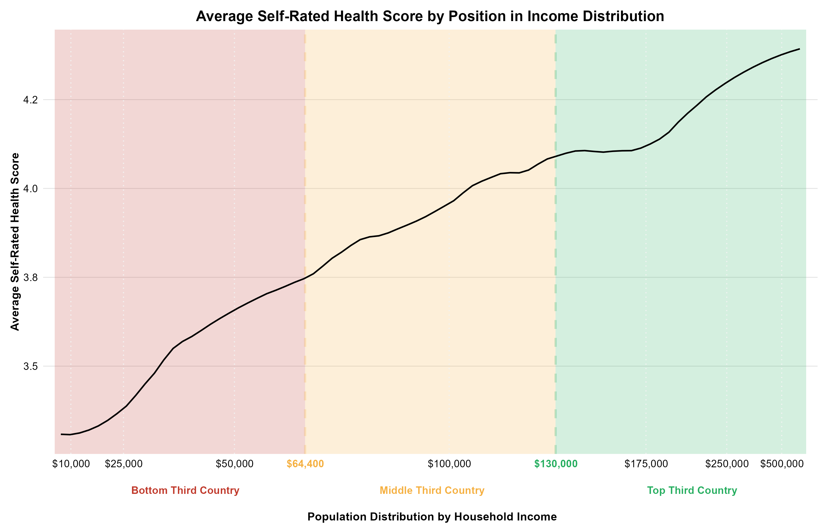
Self-Rated Health Score
Health

Slide 23
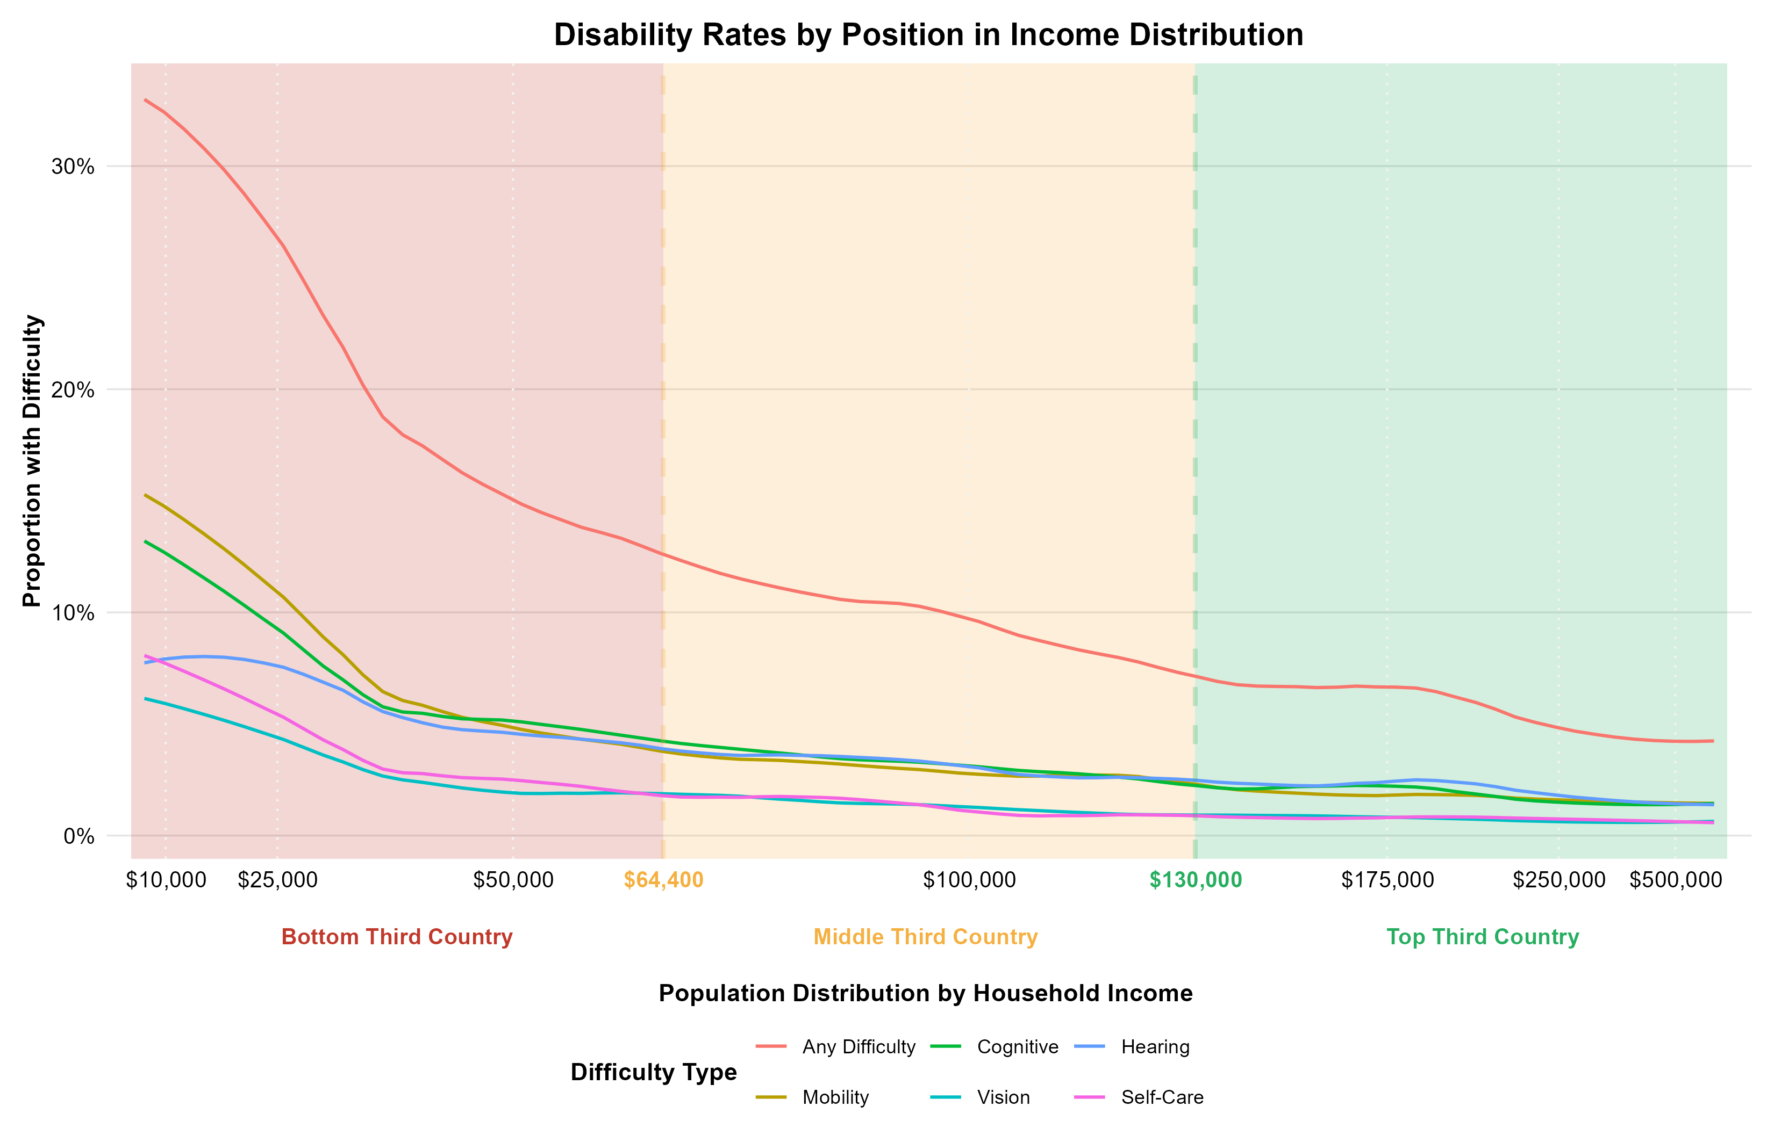
Disability Rates
Health

Slide 24
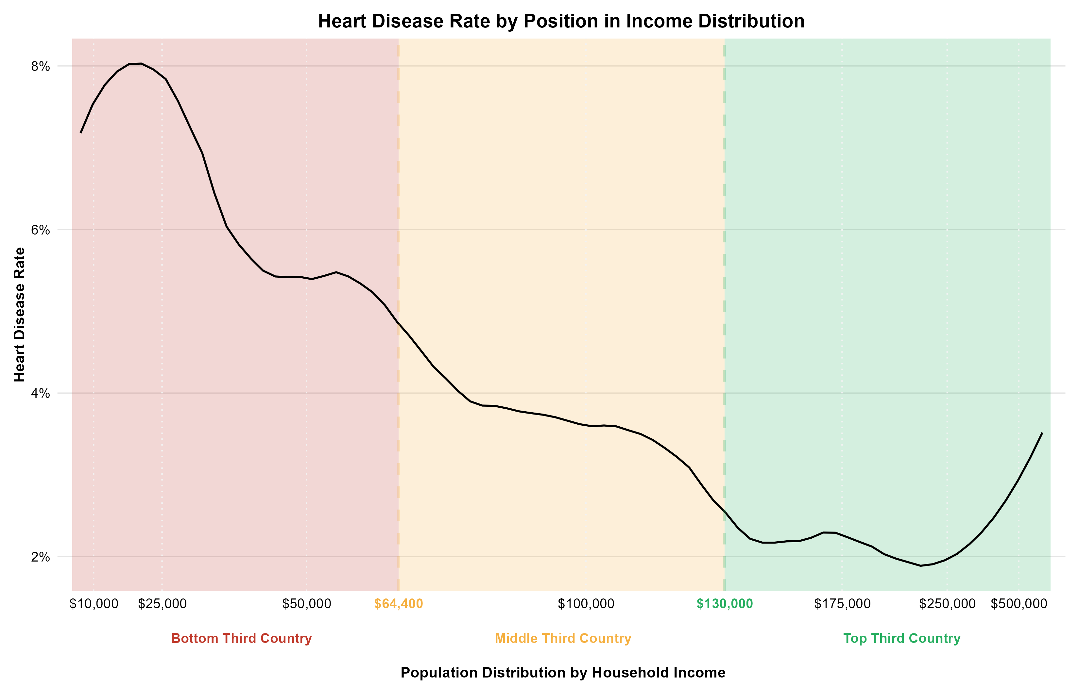
Heart Disease Rate
Health

Slide 25
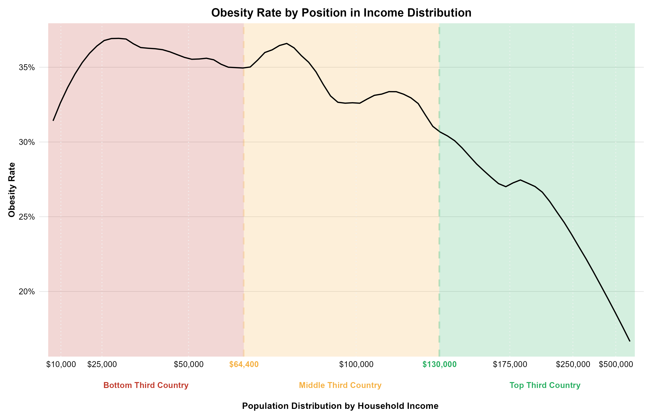
Obesity Rate
Health

Slide 26
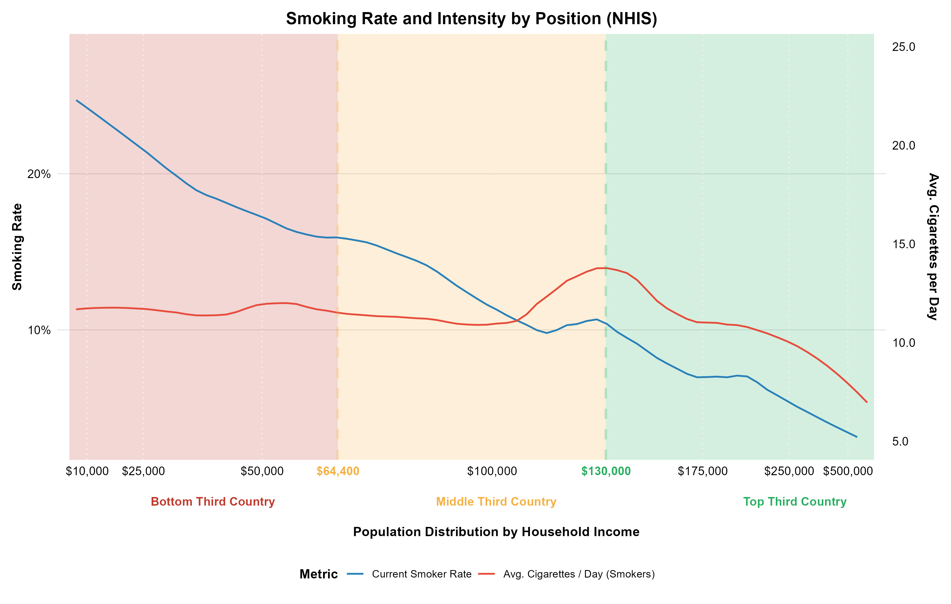
Smoking Rate & Cigarettes Smoked Per Day
Health

Slide 27
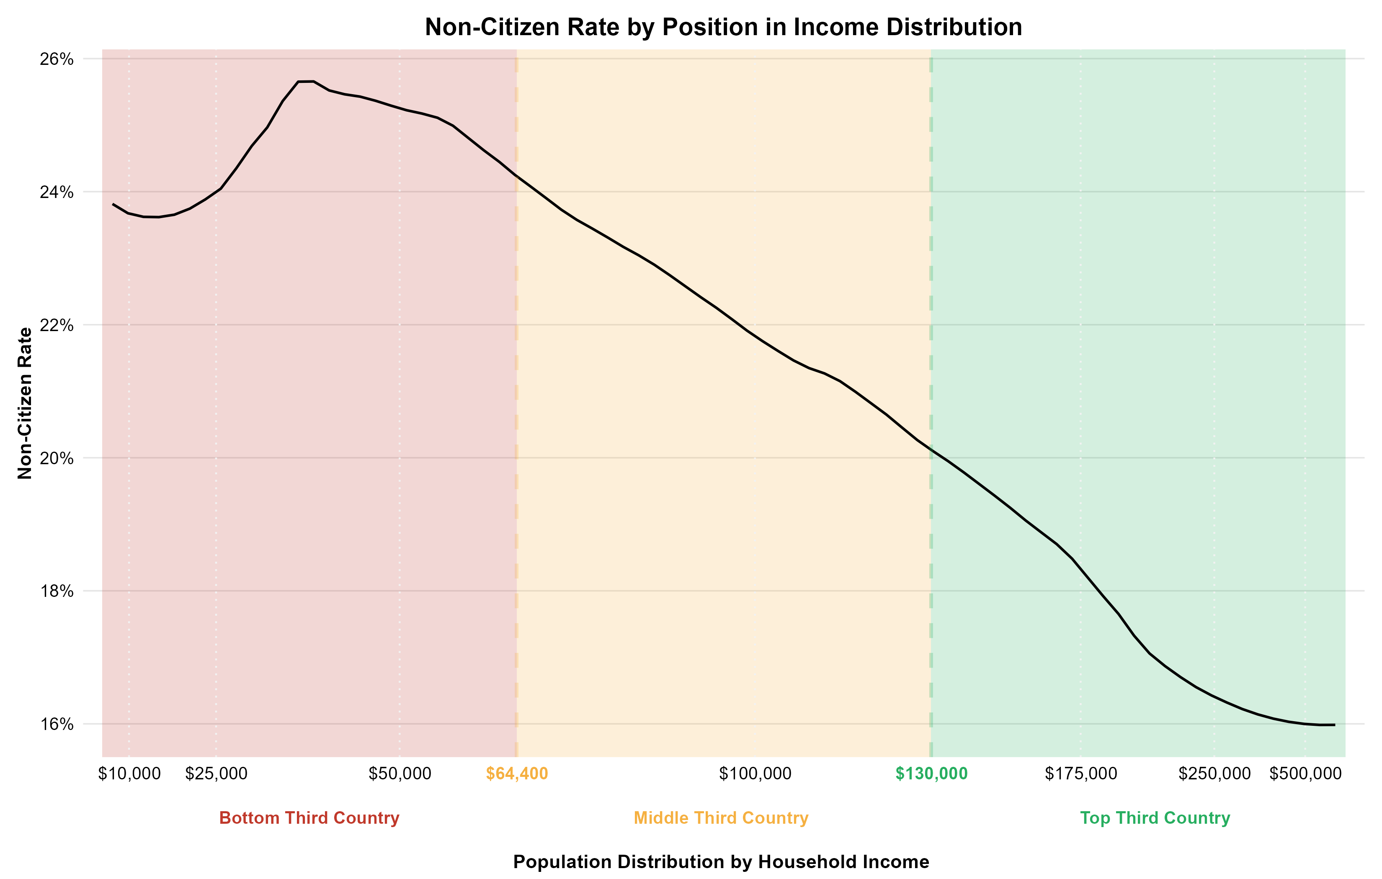
Non-Citizen Rate
Civic Engagement

Slide 28
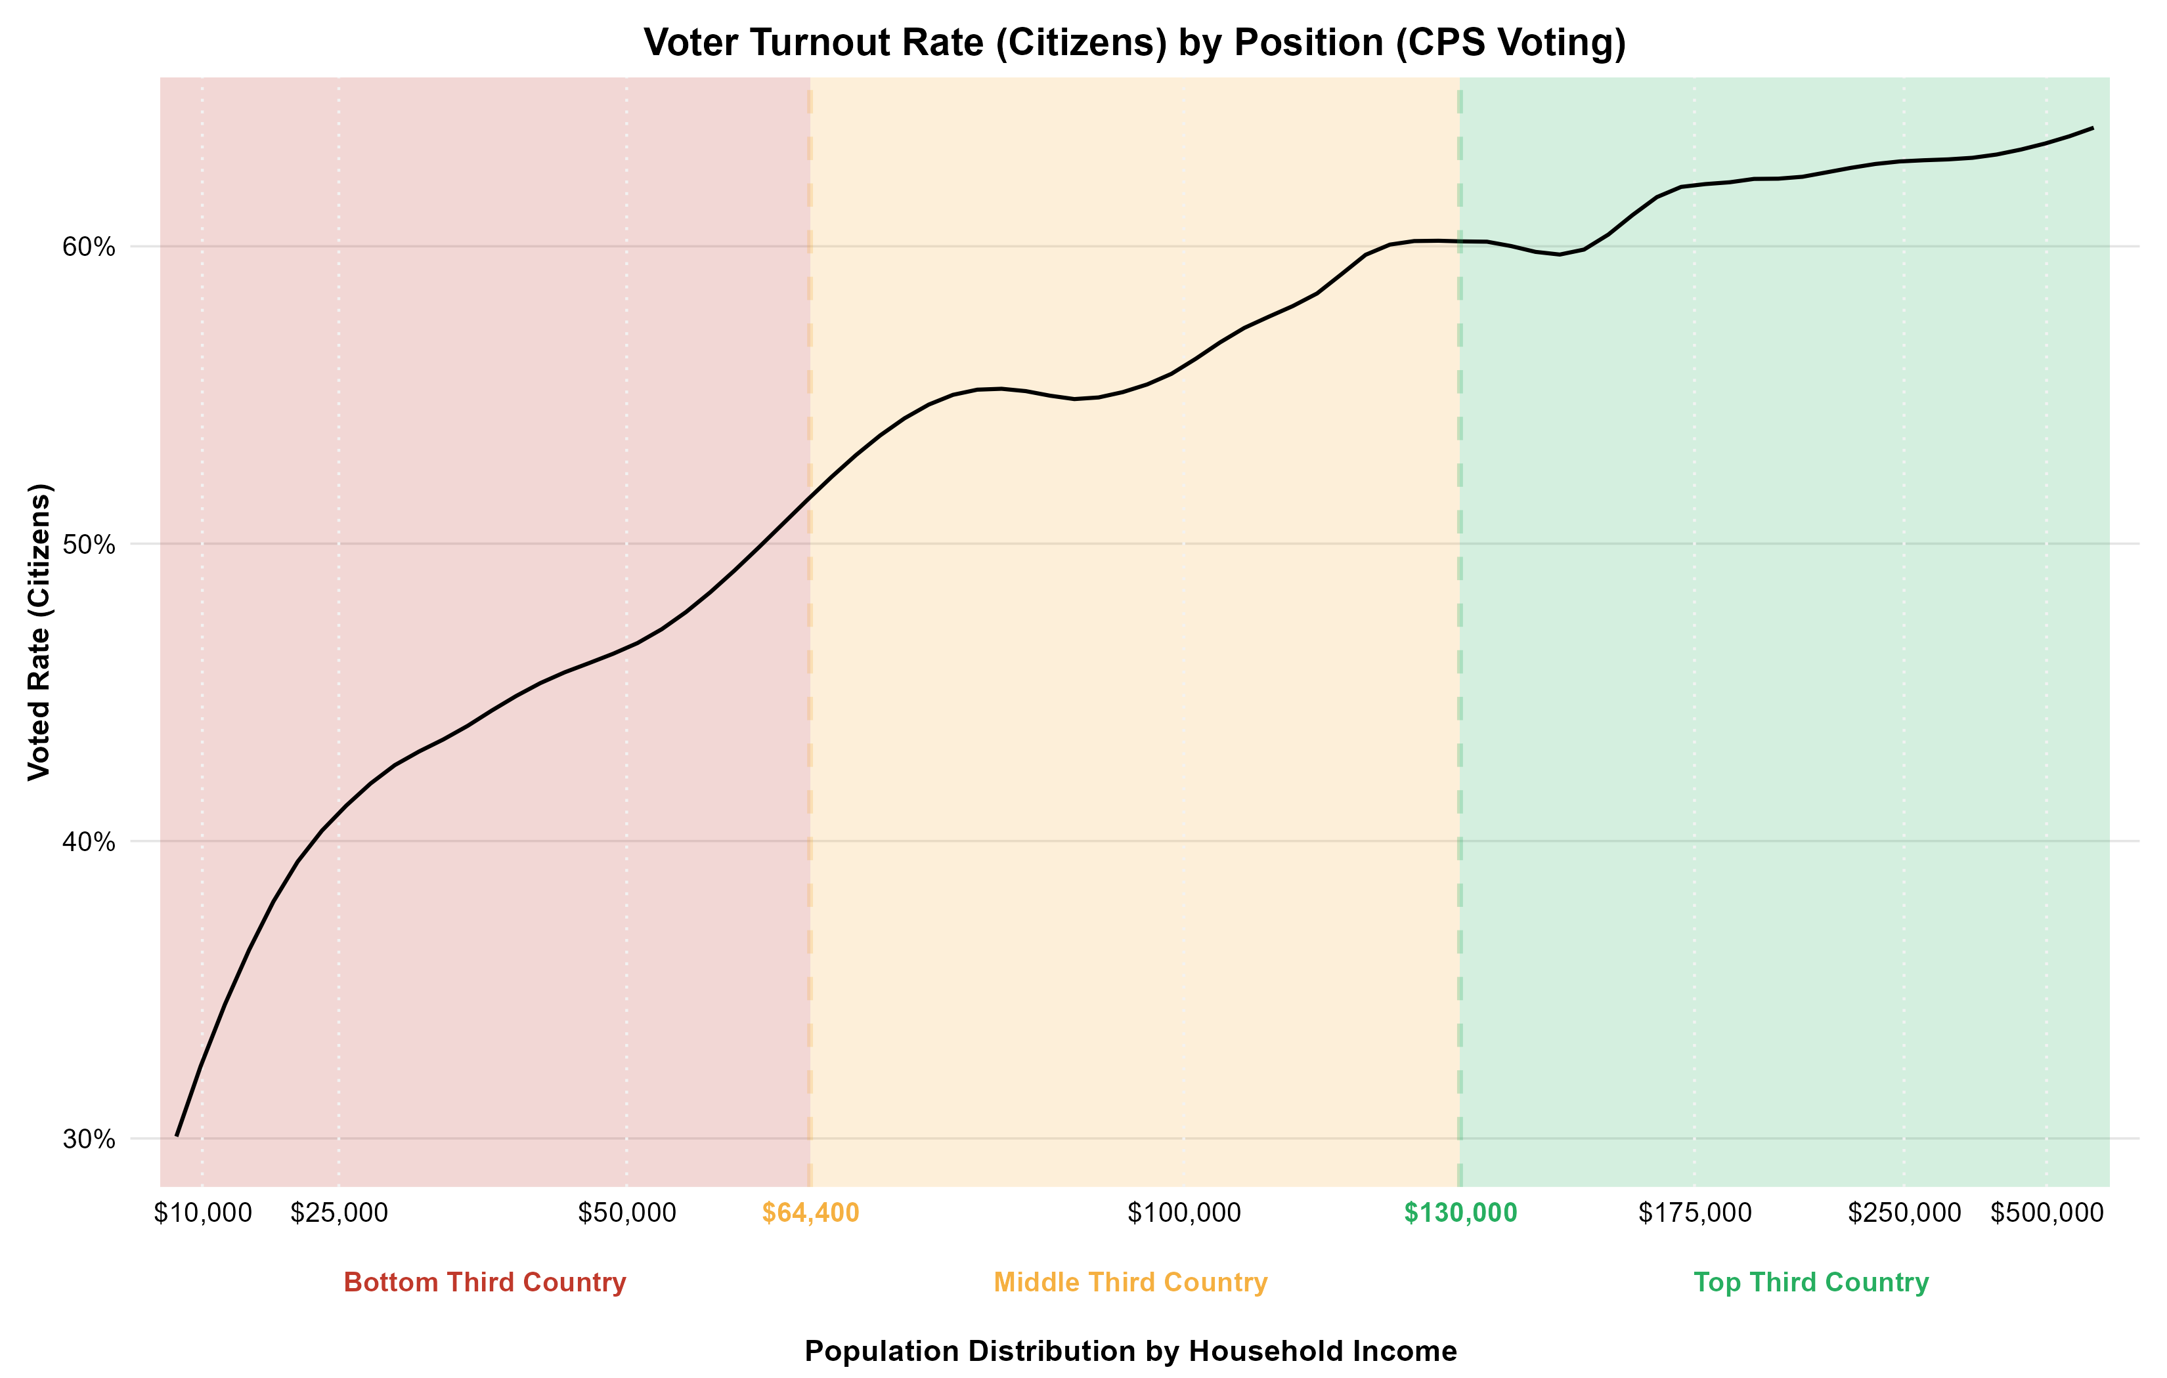
Non-Citizen Rate
Civic Engagement

Slide 29
Implications for Science Policy
Persistent disparities suggest current science policy approaches are insufficient.
Science policy must be intentionally reoriented to identify, prioritize, and tackle complex, interconnected societal challenges ("wicked problems").
Requires integrated efforts focused on equitable outcomes and societal impact.

Slide 30
Significance and Future Direction of Framework
Framework provides a robust, scalable tool for understanding conditions across the income spectrum.
Foundation for future work:
Synthesized model with hundreds of indicators.
Temporal analysis (tracking changes over time).
Geographic analysis (mapping spatial disparities).
Informs efforts to foster more inclusive and equitable progress via science & innovation policy.

Slide 31


